Slide 1
Module 02 : Updating Windows 10

Slide 2
Module Agenda
Windows Servicing Model
Updating Windows

Slide 3
Lesson 1: Windows Servicing Model

Slide 4
Lesson 1: Windows Servicing Model
The Windows Servicing Model
Windows 10 Servicing Channels
Windows Update Options
Notes:
Provide an overview of the lesson.
Question
What are the benefits to small and medium-sized organizations of using Windows 10? (Choose all that apply)
( ) Option 1: Windows 10 is easy to use.
( ) Option 2: Windows 10 is provided with continuous updates.
( ) Option 3: Microsoft provides Windows 10 as a free upgrade for Windows 7 Enterprise users.
( ) Option 4: Windows 10 provides improved device management.
Answer
(√ ) Option 1: Windows 10 is easy to use.
(√ ) Option 2: Windows 10 is provided with continuous updates.
( ) Option 3: Microsoft provides Windows 10 as a free upgrade for Windows 7 Enterprise users.
(√ ) Option 4: Windows 10 provides improved device management.
20697-1D
1: Overview of Windows 10

Slide 5
Windows Servicing Model
Feature updates | A new Windows 10 release that contains additional features and capabilities, released two to three times per year.
Quality updates | In Windows 10 rather than receiving several updates each month and trying to figure out which the organization needs, which ultimately causes platform fragmentation, administrators will see one cumulative monthly update that supersedes the previous month’s update, containing both security and non-security fixes.
Channel | The windows servicing channel is one of three choices: Windows Insider, Semi-Annual Channel, or Long-Term Servicing Channel. Channels allow customers to designate how frequently their individual devices are updated.
Ring | These are simply a method by which to separate machines into a deployment timeline. The windows servicing rings are Preview, Targeted, Broad, and Critical.

Slide 6
Windows 10 Servicing Channels
Servicing option | Application | Availability
Semi-Annual Channel (Targeted) | Feature updates available immediately after publication | All the main editions of Windows 10
Semi-Annual Channel | Feature updates available approximately four months after publication | All editions of Windows 10 except the home edition
Long-Term Servicing Channel | Long-term deployment of selected Windows 10 releases with minimal feature updating | Only available on the Enterprise LTSB edition of Windows 10
Windows Insider Program | Preview feature updates before they are released to the Semi-Annual Channel | All the main editions of Windows 10
Notes:
This is an emerging concept, and is subject to change.
20697-1D
12: Maintaining Windows 10

Slide 7
Windows Update Options
Servicing Tool | Can updates be deferred? | Ability to approve updates | Peer-to-peer option | Additional features
Windows Update | Yes (manual) | No | Delivery Optimization | None
Windows Update for Business | Yes | No | Delivery Optimization | Other Group Policy objects
WSUS | Yes | Yes | BranchCache or Delivery Optimization | Upstream/downstream server scalability
Microsoft Intune | Yes | Yes | Delivery Optimization | Cloud-based Management
Configuration Manager | Yes | Yes | BranchCache, Client Peer Cache | Distribution points, multiple deployment options

Slide 8
Lesson 2: Updating Windows

Slide 9
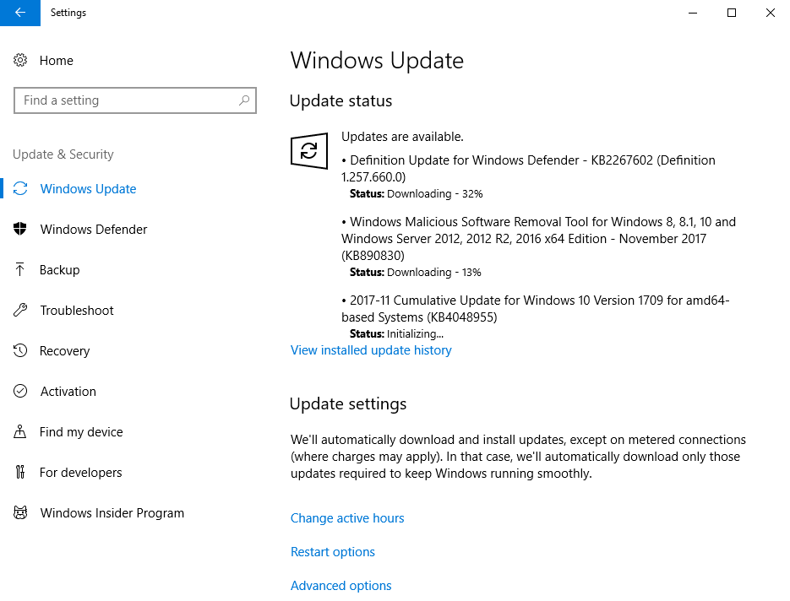
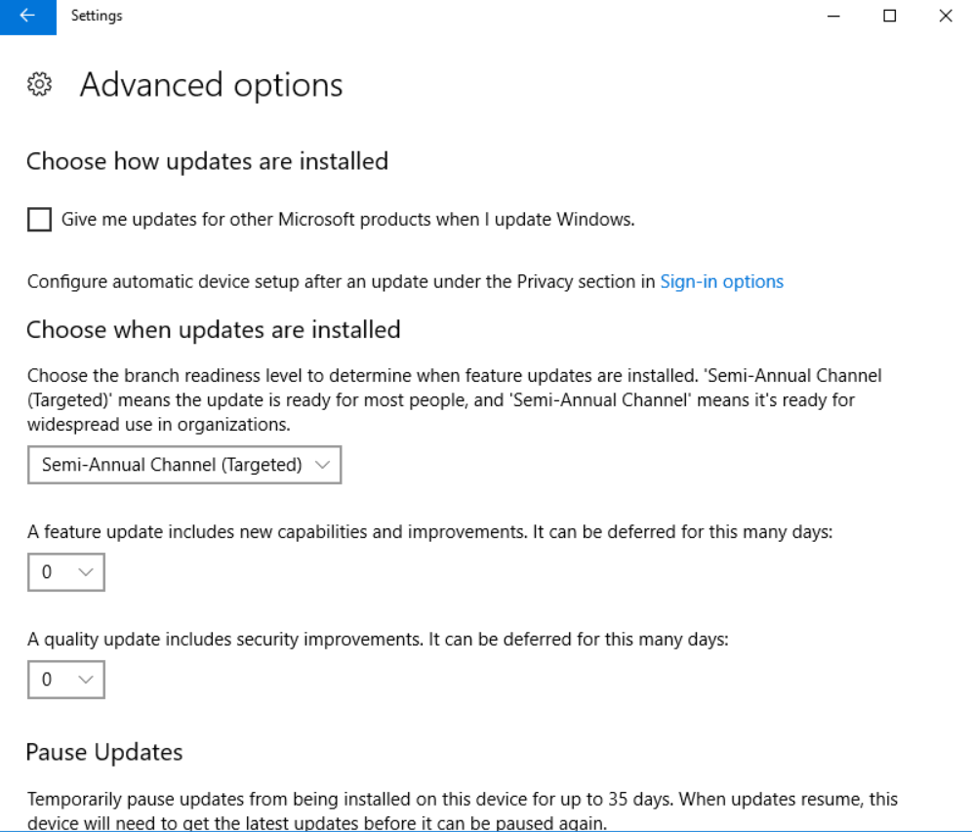
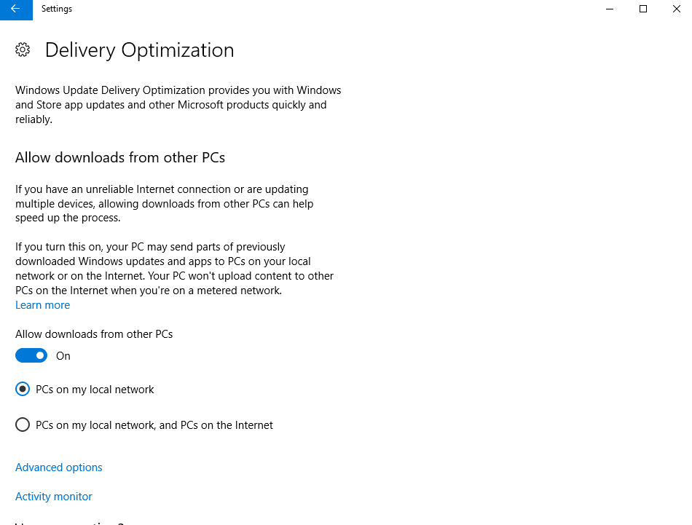
Windows Update settings in Windows 10
Notes:
Note: This topic has five additional slides.
You will demonstrate these options in an upcoming topic. Use the additional slides if you do not wish to perform the demonstration, or while you are discussing the content in this topic.
20697-1D
12: Maintaining Windows 10

Slide 10






Using a WSUS Server to deploy updates
Microsoft Update website
Automatic updates
Server running
WSUS
Test clients
LAN
Internet
Automatic updates
Notes:
Note: This topic has one additional slide.
This topic introduces students to Windows Server Update Services (WSUS). Make sure that students understand the capabilities and limitations of WSUS. WSUS obtains updates for Windows operating systems and for other Microsoft application software, such as Microsoft SQL Server.
Do not go into too much detail here as it is outside the scope of this course. However, students should be aware of WSUS functionality and its effect on update delivery to Windows 10-based computers and devices.
When discussing the WSUS update process, display the second graphic.
20697-1D
12: Maintaining Windows 10

Slide 11
Windows Update for Business
Windows Update for Business delivers updates differently than WSUS, and has the following characteristics:
Distribution rings
Deferring updates:
Quality Updates. Defers updates up to 30 days and pauses for up to 35 days
Feature Updates. Defers updates up to 365 days and pauses for up to 35 days
Drivers. Excludes drivers from updates
Maintenance windows
Delivery optimization
Integration with:
System Center Configuration Manager
Microsoft Intune
Notes:
This is a new way of applying updates in business scenarios, so students will be unfamiliar with it. Compare Windows Update for Business with WSUS, a service most students will understand. Highlight significant differences.
20697-1D
12: Maintaining Windows 10

Slide 12
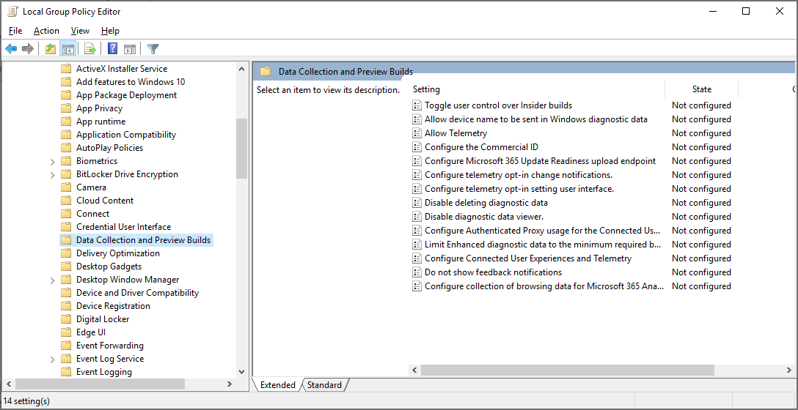
Using Group Policy Settings for Configuring Windows Update
Notes:
Consider demonstrating the configuration of these settings.
Windows 10 adds several settings to Computer Configuration/Policies/Administrative Templates /Windows Components/Windows Update. Additionally, the settings in Computer Configuration /Policies/Administrative Templates/Windows Components/Data Collection and Preview Builds, and Computer Configuration/Policies/Administrative Templates/Windows Components/Delivery Optimization are specific to Windows 10.
20697-1D
12: Maintaining Windows 10

Slide 13
Practice Lab – Updating Windows 10

